Slide 1

Java Programming
Subject code :-cucs1004
Guided by :-MR M.Aswin kumar
PRESENTED BY:-
Asha nakkana (231801130027)
M.Poojitha (231801410020)
K.Vijaya Laxmi(231801400008)
V.Dinesh Kumar (231801130012)
Ch.varun kumar(2318011300210)
B.Durgaprasad(231801410021)

Slide 2
Otp Based Login System

Slide 3
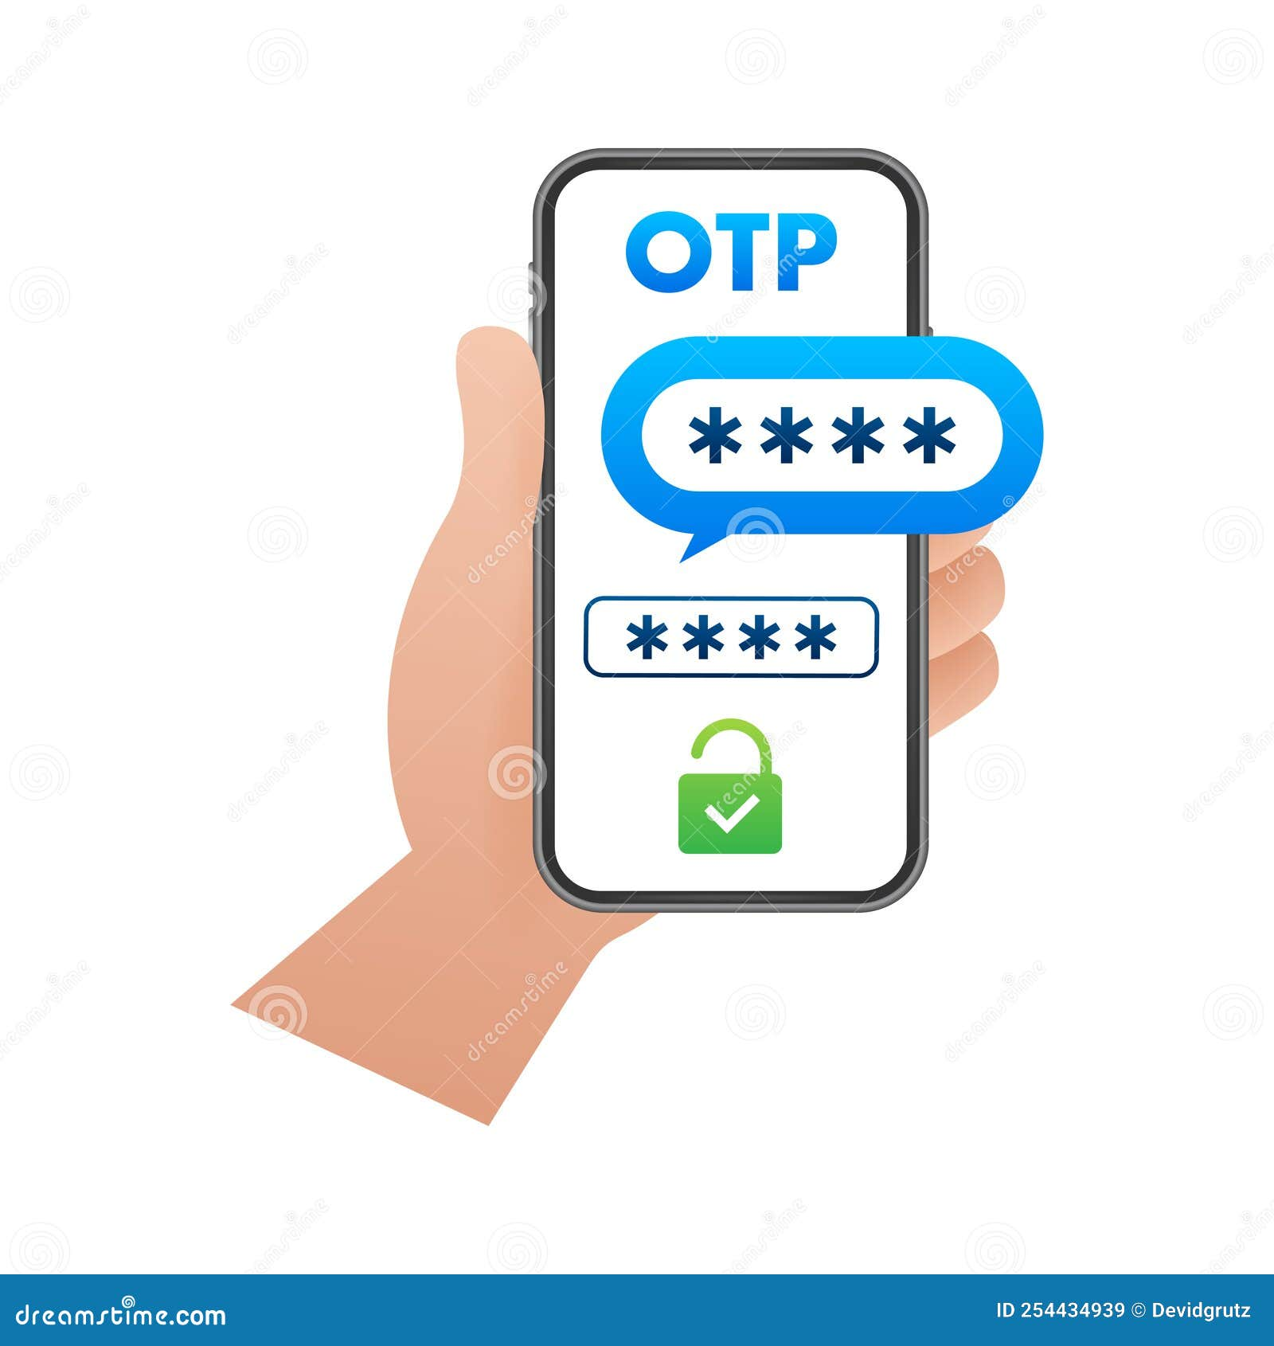
Introduction to OTP-Based Login System
OTP stands for One-Time Password, a security feature for user authentication.
This method generates a unique password for each login attempt, enhancing security.
OTPs can be delivered via SMS, email, or authenticator apps, providing convenience.
Notes:
Image source: https://thumbs.dreamstime.com

Slide 4

How OTPs Work
When a user attempts to log in, a request is sent to the server for an OTP.
The server generates a random OTP and sends it to the user’s registered contact method.
The user must enter the OTP within a specific time frame to complete the login process.
Notes:
Image source: https://d.wattpad.com

Slide 5

Benefits of OTP-Based Login
OTPs significantly reduce the risk of unauthorized access to user accounts.
They eliminate the reliance on static passwords, which can be easily compromised.
Users can feel more secure, knowing that their login credentials are not stored long-term.
Notes:
Image source: https://www.dewpoint.com

Slide 6
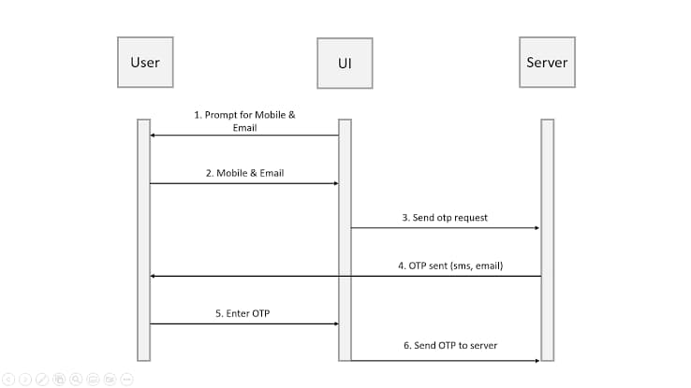
Types of OTP Generation
Time-based OTPs (TOTP) change based on time intervals, typically every 30 seconds.
Event-based OTPs (HOTP) are generated based on a counter, increasing with each request.
Both methods can be implemented in various applications, enhancing flexibility.
Notes:
Image source: https://www.researchgate.net

Slide 7

Delivery Methods for OTPs
SMS is a common method, where users receive the OTP as a text message.
Email delivery is another option, allowing users to check their inbox for the OTP.
Authenticator apps provide a more secure method, generating OTPs directly on the device.
Notes:
Image source: https://www.textmessage.pro

Slide 8
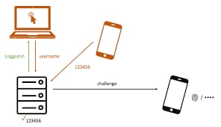
Security Considerations
While OTPs enhance security, they are still susceptible to interception if not secured.
Users must be educated about phishing attacks that could compromise their OTPs.
Implementing encryption for OTP transmission can significantly reduce risks.
Notes:
Image source: https://www.slidemake.com

Slide 9

Implementing OTP in Applications
Developers can integrate OTP systems using APIs provided by third-party services.
Custom implementations require careful consideration of security and usability.
Testing the OTP system is essential to ensure reliability and user satisfaction.
Notes:
Image source: https://arkesel.com

Slide 10
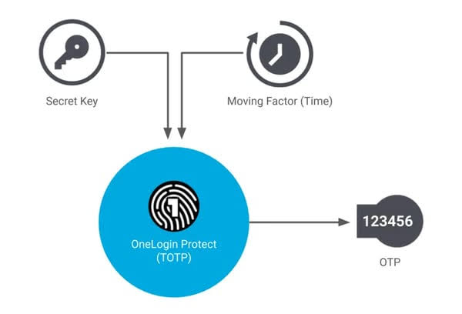
Challenges of OTP-Based Systems
Users may face issues if they do not receive their OTP due to network problems.
OTPs can be cumbersome for users who prefer quick access without extra steps.
Balancing security with user experience is a constant challenge for developers.
Notes:
Image source: https://www.slidemake.com

Slide 11

Future Trends in OTP Technology
Biometric authentication may complement or replace OTPs for enhanced security.
The use of machine learning can improve OTP generation and detection of anomalies.
As technology evolves, integrating OTPs with multi-factor authentication will become standard.
Notes:
Image source: https://themerkle.com

Slide 12
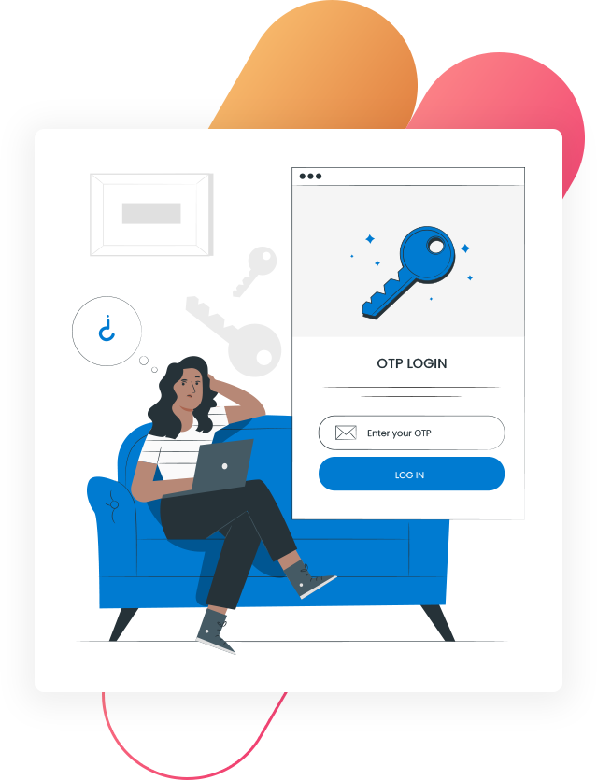
Conclusion
OTP-based login systems are a vital component of modern digital security strategies.
Their ability to provide temporary, secure access makes them a preferred choice.
Continued advancements will likely make OTPs even more reliable and user-friendly.
Feel free to modify or expand upon any slide to better suit your presentation needs!
Notes:
Image source: https://digital-tricksters.com

Slide 13
THANKYOU

